Slide 1
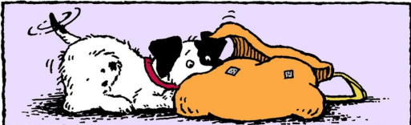
Maria Goes to School

Slide 2
Click to see What stationery should you bring.
pencils
ruler
backpack
eraser
crayons
sweater
brother
lunch
bug

Slide 3
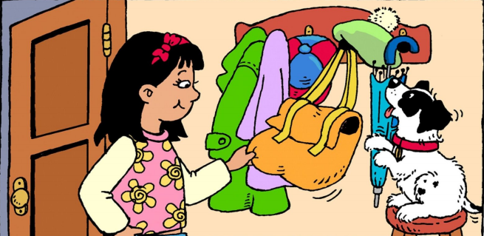
I get my backpack.
Return

Slide 4
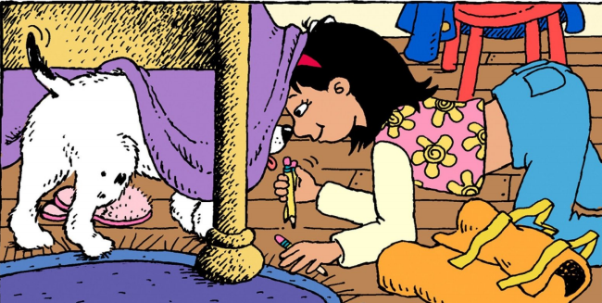
I get my pencils.
Return

Slide 5
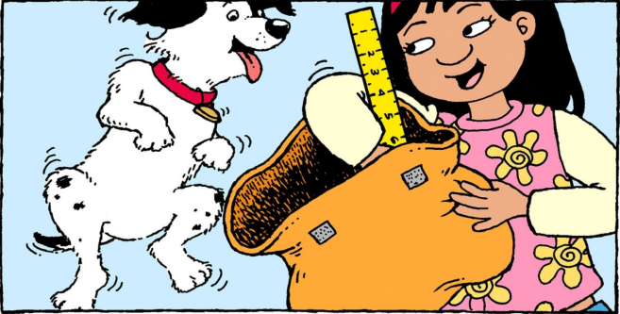
I get my ruler.
Return

Slide 6
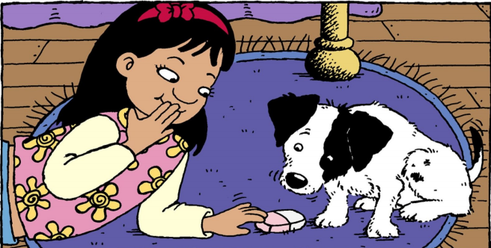
I get my eraser.
Return

Slide 7
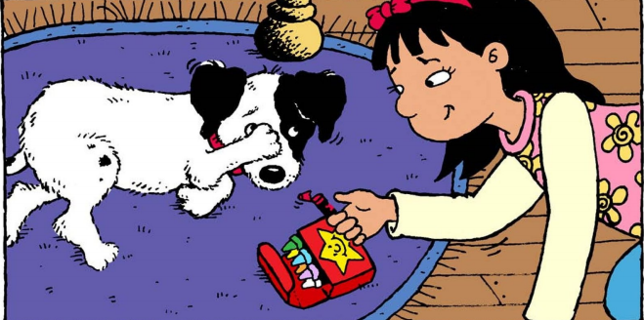
I get my crayons.
Return

Slide 8
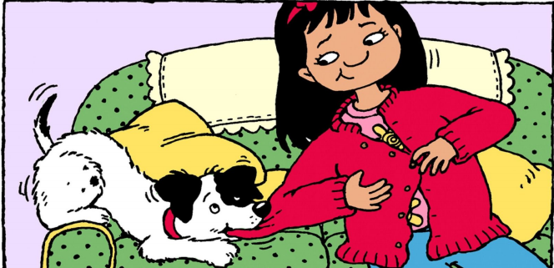
I get my sweater.
Return

Slide 9
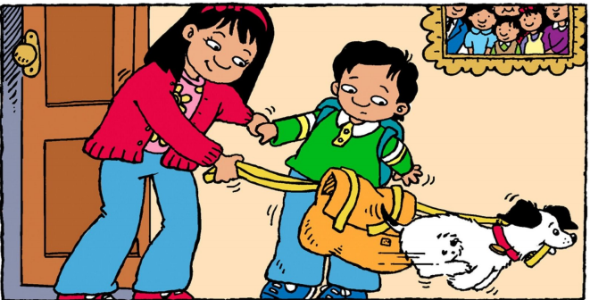
I get my brother.
Return

Slide 10
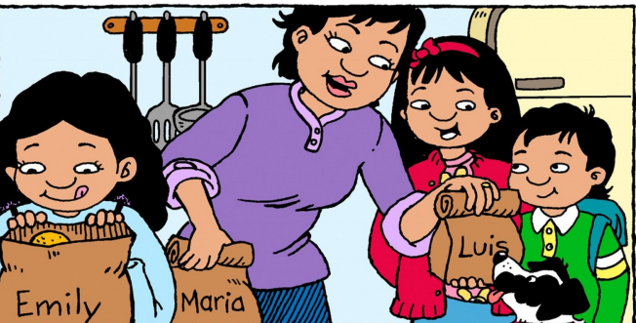
I get my lunch.
Return

Slide 11
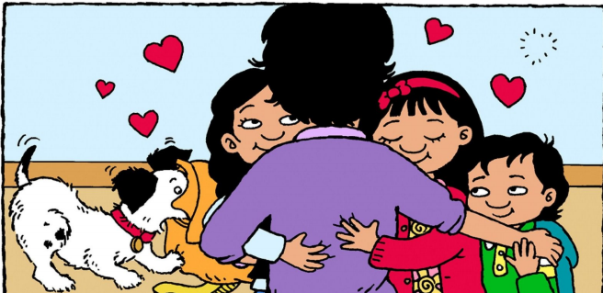
I get my bug.
Return

